Slide 1



CONSUMER GOODS
AD-HOC INSIGHTS
Presented by: Dokari Sai Dhanush

Slide 2
OBJECTIVE
Atliq Hardware (imaginary company) is one of the leading computer hardware producers in India and well expanded in other countries too.
However, the management noticed that they do not get enough insights to make quick decisions.
They want to expand their data analytics team by adding several junior data analysts.
Tony Sharma, their data analytics director wanted to hire someone who is good at both tech and soft skills
Hence, he decided to conduct a SQL challenge which will help him understand both the skills.

Slide 3
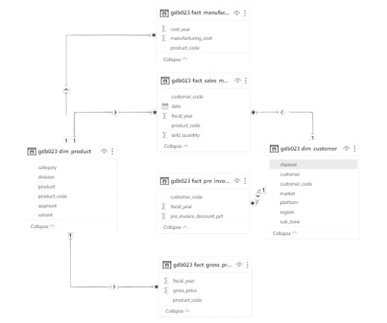


Data Requests and Tools

Slide 4
INSIGHTS

Slide 5
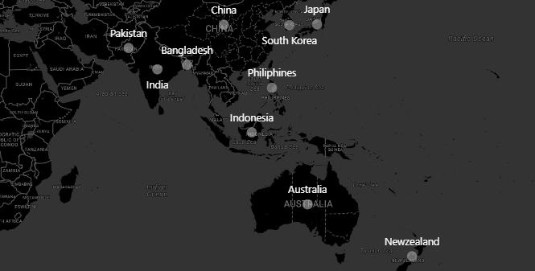

1. Provide the list of markets in which customer "Atliq Exclusive" operates its business in the APAC region.

Slide 6

2.What is the percentage of unique product increase in 2021 vs. 2020?
OUTPUT:
Insights:
Over the course of 2021, AtliQ Hardware elevated their product range from 245 to 334, signaling a commendable 36% growth.

Slide 7
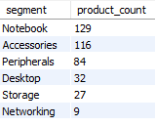
3. Provide a report with all the unique product counts for each segment and sort them in descending order of product counts. The final output contains 2 fields, segment , product_count
OUTPUT:
Insights:
While Atliq Hardware boasts a strong lineup in notebooks, peripherals, and accessories, they should consider venturing into desktops, storage, and networking to truly cater to all tech needs.

Slide 8
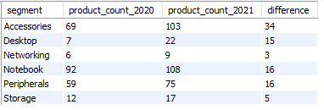
4.Which segment had the most increase in unique products in 2021 vs 2020?
OUTPUT:
Insights:
Accessories led the charge with 34 new products added to their lineup in 2021, representing a significant 34-point jump over 2020.

Slide 9

5. Get the products that have the highest and lowest manufacturing costs.
OUTPUT:
Insights:
The Allin1 Gen 2 reigns supreme in terms of manufacturing cost, while the Master wired x1 Ms reigns itakes the bottom rung.

Slide 10
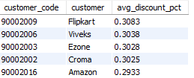
6.Generate a report which contains the top 5 customers who received an average high pre_invoice_discount_pct for the fiscal year 2021 and in the Indian market.
OUTPUT:
Insights:
Flipkart takes the crown! with the highest average pre-invoice discount percentage, boasting a remarkable 30.83%.

Slide 11
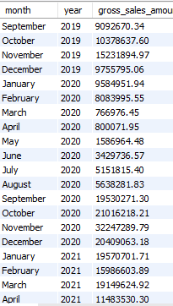
7. Get the complete report of the Gross sales amount for the customer “Atliq Exclusive” for each month . This analysis helps to get an idea of low and high-performing months and take strategic decisions.
Insights:
The lowest Gross sales total for both fiscal years is in March (2020).
The highest Gross sales total for both fiscal years is in November (2020).

Slide 12

8. In which quarter of 2020, got the maximum total_sold_quantity?
OUTPUT:
Insights:
Outpacing all other quarters, Q1 2020 saw the highest total sales figure with a remarkable 7,005,619 units sold.

Slide 13

9.Which channel helped to bring more gross sales in the fiscal year 2021 and the percentage of contribution?
OUTPUT:
Insights:
In fiscal year 2021, the Retailer channel reigned supreme, driving the highest gross sales with a staggering ₹1924.17 million, accounting for a remarkable 73.22% of the total contribution.

Slide 14
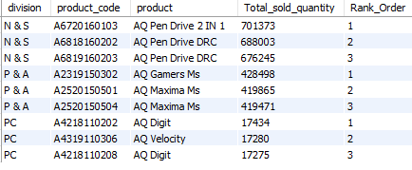
10. Get the Top 3 products in each division that have a high total_sold_quantity in the fiscal_year 2021?
Across all divisions, a remarkable feat occurs – at least one product with diverse variants claims two spots in the top three best-selling products each time.

Slide 15

THANK YOU
For watching this presentation
Sai Dhanush

